Slide 1

Notes:
.

Slide 2


Slide 3
HTML Background
What is HTML?
Stands for Hyper Text Markup Language
Markup languages are
Finding and navigating documentation
Every language has documentation and it can be really useful if you’re trying to figure out how to do something
Man pages
If there’s a unix command and you need more information about it, you can type “man commandname” and get more information about it

Slide 4

Visual Studio Code
Recommended text editor
Notes:
Alli: go to downloads, Install vscode. Install tslint

Slide 5
Editors
Your editor is your main instrument to craft a program
– Chefs use the best knife
– Mechanics use the best wrenches
– Bakers use the best ovens
– And they know the ins and outs of their tool
Invest time in learning your editor, whatever it is. Everyone has a different “optimal” setup and that’s okay!

Slide 6
Developer Tools
First.. What happens if you get stuck?
Google for errors
Stackoverflow is your best friend
Finding and navigating documentation
Every language has documentation and it can be really useful if you’re trying to figure out how to do something
Man pages
If there’s a unix command and you need more information about it, you can type “man commandname” and get more information about it

Slide 7

Git Bash (for Windows)
Notes:
If they have Windows Subsystem for Linux or Git Bash already, this step is unnecessary

Slide 8
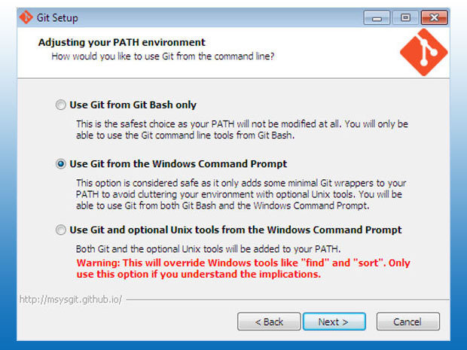
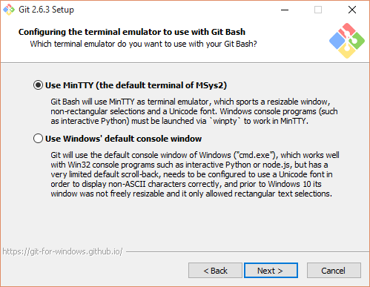
Git Bash (Windows only)

Slide 9
Git Bash (Windows Only)

Slide 10
Terminal
The UNIX/POSIX/Linux command line is an amazing tool
– Command composition
– Output redirection
– Background tasks
– Sleeping
Notes:
You’ll have to run `yarn build` and `yarn dev` again when you make changes and want to restart the server.

Slide 11
Terminal
UNIX commands can be very simple one word commands, or they can take a number of additional arguments (parameters) as part of the command.
UNIX command has the following form:
command options(s) filename(s)
Notes:
Alli: The command is the name of the utility or program that we are going to execute.
The options modify the way the command works. It is typical for these options to have be a hyphen followed by a single character, such as -a. It is also a common convention under Linux to have options that are in the form of 2 hyphens followed by a word or hyphenated words, such as --color or --pretty-print.
The filename is the last argument for a lot of UNIX commands. It is simply the file or files that you want the command to work on. Not all commands work on files, such as ssh, which takes the name of a host as its argument.

Slide 12
HTML Basics
ls : lists the contents of a directory
pwd : prints the current working directory
cd : changes directorie
The difference between relative and absolute paths.
Special characters ., .., and ~.
Notes:
Alli:

Slide 13
Terminal
cp : copies a file from one directory to another
mv : moves a file from one directory to another
mkdir : creates a directory
rm -rf : removes a directory and all of its contents
Notes:
Alli:

Slide 14

Node.js
Notes:
If they have Windows Subsystem for Linux or Git Bash already, this step is unnecessary

Slide 15

Github

Slide 16
Github
Go to github.com
Sign up
Pick a username you can put on your resume
Use your .edu Email
Notes:
Alli:

Slide 17
Notes:
Lewis: GoodMorning, First thing first, Head to this google link, and lets get you downloading the necessary packages.

